Slide 1
SMART SOLUTION FOR RAILWAYS
Team id : PNT2022TMID41264
Team Lead : Bharanikavi M
Team Member 1: Gokulakannan C
Team Member 2: Piraisudan D
Team Member 3: Dinesh N
Team Member 4: Sanjay M
Mentor : Thiyagarajan R

Slide 2
Introduction
Smart solution for railways is to implement smart things or ideas to reduce the workload of the user.
The smart things includes applications, websites, and digital devices.
Applications and websites are already existing for booking tickets, live status of the train, seat availability and so on.

Slide 3
Drawback in existing systems
Existing system only having ticket booking facilities not focused to reduce the paper use.
The existing system does not give digital methods to verify the tickets to the ticket collector.

Slide 4
Objective of our project
Smart solution for railways is designed to reduced the work load of the user and also the use of paper.
The main features of the project is to create a web page for booking tickets.
A web app to know live status of the train.

Slide 5
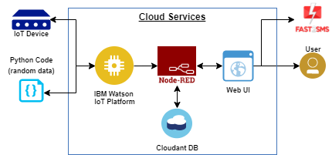
Flow Diagram

Slide 6


Methodologies
Python
IBM Watson IoT platform
Node-Red services
Cloudant database
MIT app inventor

Slide 7

Python
Python script is for indicating live status of the train.
Another python program for scanning the QR code.

Slide 8
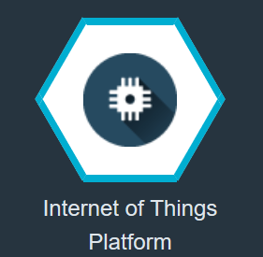
IBM Watson
IBM Watson IoT platform acts as the mediator to connect the web application to IoT device.
Python program is linked to the IBM Watson IoT platform by using device credentials for seeing the python output in the IBM Watson IoT platform.

Slide 9

Node-Red
Node-Red is a programming tool for wiring together hardware devices, APIs and online services in new and interesting ways.
Generating a QR code is designed in the node-red flow and the node-red dashboard is designed as a web UI.

Slide 10

Cloudant Database
Dashboard is created in the cloudant database for storing the booking details of the passengers.
Node-red is linked to the cloudant database using API keys.
While Ticket Collector scanning the QR code the data of the passengers are retrieved form the cloud.

Slide 11

MIT App Inventor
Create an mobile application using MIT app inventor.
By using MIT app inventor front end of the application was designed.
The node-red dashboard and world map UI is linked to the MIT app inventor for booking the tickets and to know the live status of the train.

Slide 12
Future challenges
Users do not have mobile phones are not able to use this application.
Server maintenance is a difficult task.
To provide safe and secure user credentials

Slide 13
Reference
D'silva, G.M., Scariah, A.K., Pannapara, L.R. and Joseph, J.J., 2017, February. Smart ticketing system
for railways in smart cities using software as a service architecture. In 2017 International Conference on I-SMAC (IoT in Social, Mobile, Analytics and Cloud)(I-SMAC) (pp. 828-833). IEEE.
Jo, O., Kim, Y.K. and Kim, J., 2017. Internet of things for smart railway: feasibility and applications. IEEE Internet of Things Journal, 5(2), pp.482-490.
Fraga-Lamas, P., Fernández-Caramés, T.M. and Castedo, L., 2017. Towards the Internet of smart trains: A review on industrial IoT-connected railways. Sensors, 17(6), p.1457.

Slide 14
Thank You

